Slide 1

Designing of IoT Solutions
Case studies
Rashma.B.M
Department of Computer Science Engineering

Slide 2

Designing of IoT Solutions
Case study :Smart city
Rashma.B.M
Department of Computer Science Engineering

Slide 3
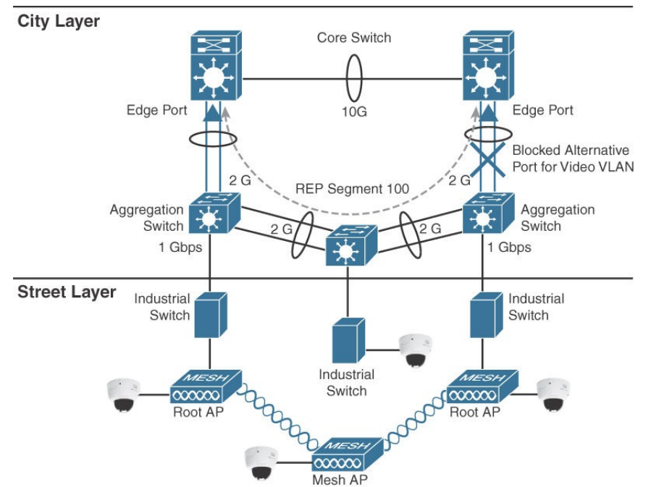
Designing IoT Solutions
Smart city architecture- proposed by cisco

Slide 4
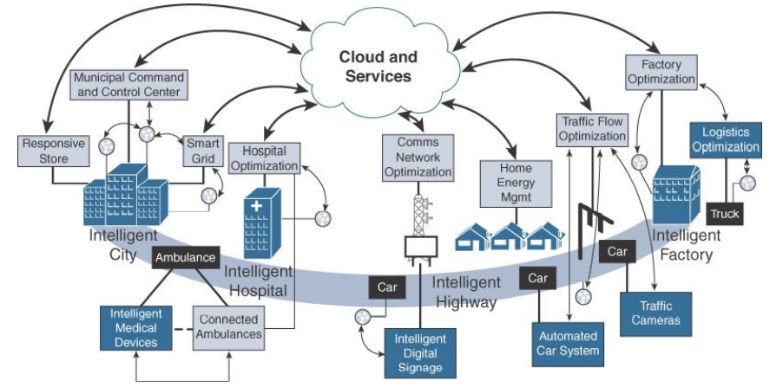
Designing IoT Solutions
Smart city architecture- proposed by cisco

Slide 5
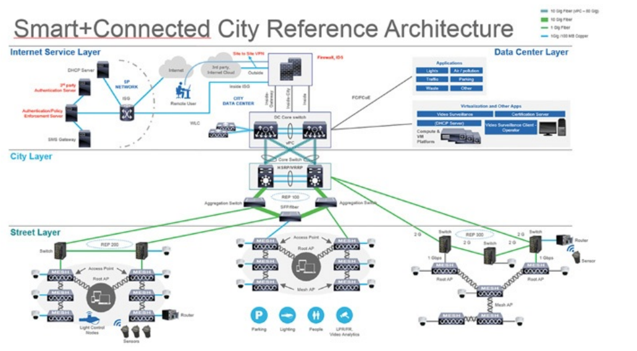
Designing IoT Solutions
Smart city architecture- proposed by cisco

Slide 6
THANK YOU
Rashma.B.M
Department of Computer Science Engineering
rashmabm@pes.edu

